Slide 1
Warm-up
Write about your thanksgiving break in 4 to 6 sentences.

Slide 2
Unit 6: Logarithmic Functions

Slide 3
Exponential Function
Where b is the base and x is the exponent (or power).
If b is greater than 1, the function continuously increases in value as x increases.
A special property of exponential functions is that the slope of the function also continuously increases as x increases.

Slide 4
Logarithmic Function
Simply a way to express the value of an exponent.
The base of the logarithm is b.
The logarithmic function has many real-life applications, in acoustics, electronics, earthquakes analysis and population prediction

Slide 5
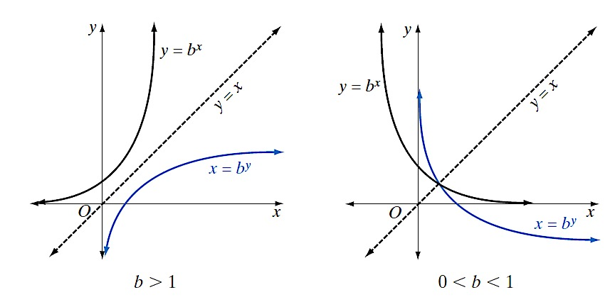
The Graph of the Exponential Function & the Inverse Function:

Slide 6
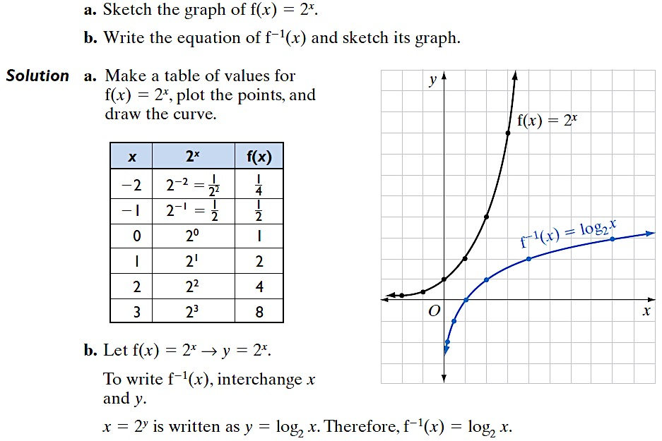
The Graph of the Exponential Function & The Inverse Function:

Slide 7
Exponential Form & Logarithmic Form
Log is just a way to ask a specific question.
log_{a}(b) asks the question:
"What exponent is required to go from a base of a in order to reach a value of b?"

Slide 9
Examples: Write in logarithmic form
1.
2.
3.
4.

Slide 10
Examples: Write in exponential form
1.
2.
3.
4.

Slide 11
Product & Addition Property

Slide 12
Examples: Write as a single log expression or write as the sum of multiple log expressions.
1.
2.
3.
4.

Slide 13
Quotient & Subtraction Property

Slide 14
Examples: Write as a single log expression or write as the difference of multiple log expressions.
1.
2.
3.
4.

Slide 15
Power & Coefficient Property

Slide 16
Important Rule!!
When you have a number under the radical we can rewrite that as a fractional exponent and then follow the Power & Coefficient Property.

Slide 17
Examples: Write the log expression with a leading coefficient or with an exponent.
3.
4.
1.
2.
5.

Slide 18
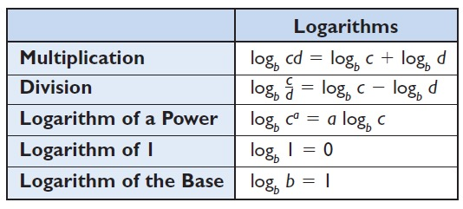
Summary

Slide 19
Put It All Together
These properties will most likely all be presented together in a question!
They will be given with all having the same base
You will be asked to expand each of the expressions using the logarithmic properties
You will be asked to write each expression as a single logarithm
OR

Slide 20
Examples: Expand or condense the following logarithmic expressions
1.
2.
3.
4.

Slide 21
Common Log
The graphing calculators are written in base 10.

Slide 22
Examples:
1.
2.
3.
4.
Remember, if you don’t see a 10 for the base it is still a common base so it can be plugged right into the calculator as is.

Slide 23
Natural Logs
All of the Log Properties also apply to natural logs
Multiplication & Addition
Division & Subtraction
Power & Coefficient

Slide 24
Examples: Simplify the following expressions
1.
2.
3.
4.

Slide 25
Examples: Simplify the following expressions
5.
6.
7.
8.

Slide 26
Examples: Solve the equation by using Natural Logs
9.
10.

Slide 27
Homework:
Complete all the even numbers from the work sheet provided

