Slide 1
The Domain & Range of a Function

Slide 2
1.
x | -6 | -2 | 0 | 3 | 5 | 8
f(x)
Were there any input values that did not give you an output?
Can you think of ANY input that would not give you an output?

Slide 3
B.
x | -1 | 0 | 1 | 2 | 3 | 4
f(x)
Which values did not give you an output? Why?
In general what values will not give you an output for this function?

Slide 4
Domain of a function
Set of all possible input (x) values that will give you an output

Slide 5
Ways to Describe the Domain
1. Inequalities
Ex) x ≥ 5 “x can be greater than or equal to 5”
Ex) 0 < x < 10 “x can be between 0 and 10”

Slide 6
2. Interval Notation
Ex) [5, ∞) “ x can be any number 5 and above”
Ex) (-∞, 0] “x can be any number 0 and below”

Slide 7
3. Exclude Values
Ex) x ≠ 2 “x can be any number except for 2”

Slide 8
If there is no limit on the numbers you are able to input then you can write the domain 3 different ways:
All Real Numbers (IR)
-∞ < x < ∞
(-∞, ∞)

Slide 9
Which parent functions will always have a domain of all real numbers?

Slide 10
Which parent functions will have a domain that is not all real numbers?

Slide 11
Ex)
Algebraic Method

Slide 12
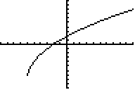
Ex)
Graphical Method

Slide 13
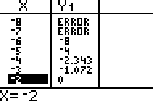
Ex)
Table Method

Slide 14
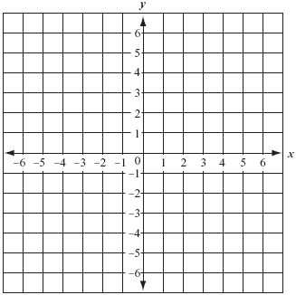
X | -4 | -3 | -2 | -1 | 0 | 1 | 2
Y
Is there a limit on how LOW the “y” values can be? ________
Is there a limit on how HIGH the “y” values can be? ________
In general what values are possible outputs for this function?

Slide 15
X | 0 | 1 | 2 | 3 | 4 | 5 | 6
Y
Is there a limit on how LOW the “y” values can be? ________
Is there a limit on how HIGH the “y” values can be? ________
In general what values are possible outputs for this function?

Slide 16
$$f\left(x\right)= x^{3}−2x$$
X | -3 | -2 | -1 | 0 | 1 | 2 | 3
Y
Considering the fact that the table and graph continue forever in both directions, is there a limit on how high or low the outputs can be?

Slide 17
Range of a function:
Set of all possible output (y) values that a function gives using all possible inputs.

Slide 18
Ex 1)

Slide 19
Ex 2)

Slide 20
Ex 3)

Slide 21

Ex 4)
$$f(x) = \frac{1}{x+3}$$

Slide 22
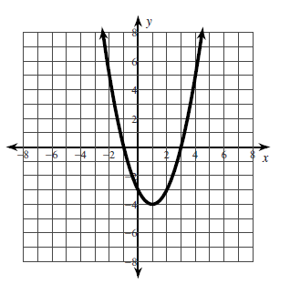
What are the domain & range of the function?
D:
R:
All real numbers
y ≥ -4

Slide 23
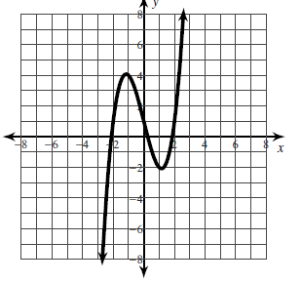
What are the domain & range of the function?
D:
R:
All real numbers
All real numbers

Slide 24
What are the domain & range of the function?
D:
R:
All real numbers
y ≤ 1

Slide 25
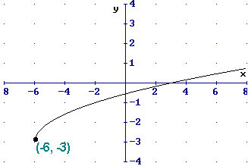
What are the domain & range of the function?
D:
R:
x ≥ -6
y ≥ -3

Slide 26
What are the domain & range of the function?
D:
R:
x ≥ -8
y ≥ 0

Slide 27
What are the domain & range of the function?
D:
R:
x ≥ 1
y ≥ 0

Slide 28
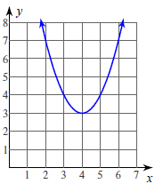
What are the domain & range of the function?
D:
R:
All real numbers
y ≥ 3

Slide 29
What are the domain & range of the function?
D:
R:
x ≥ 0
y ≥ -4

Slide 30
What are the domain & range of the function?
D:
R:
All real numbers
y ≤ -2

Slide 31
What are the domain & range of the function?
D:
R:
All real numbers
y ≥ 1

Slide 32
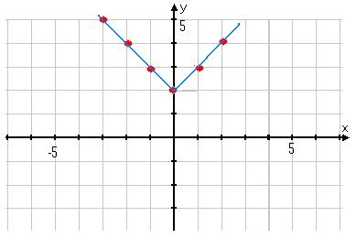
What are the domain & range of the function?
D:
R:
All real numbers
y ≥ 2

